Slide 1
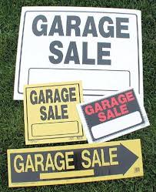
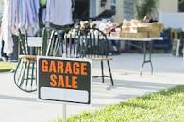
Garage sales
Code Sec (9-19) Sales commonly known as garage sales or rummage sales conducted on residential property shall be subject to the following rules and regulations:
(1)
These sales shall be conducted only by the owner or tenant of the residential property use.
(2)
No such sales shall be conducted for a longer period than seventy-two (72) hours consecutively in any six-month period on one (1) residential lot.
(3)
No wares, goods, or merchandise shall be advertised or offered for sale or swap, or given away except goods, wares, and merchandise owned by the property owner or the tenant conducting the sale.
(4)
No goods, wares, or merchandise shall be purchased by the owner or tenant for the purpose of selling, swapping, or giving away same at such a sale.
(5)
Any person desiring to conduct such a sale shall notify the administrator of the intent at least forty-eight (48) hours prior to the time the sale is to begin. The administrator or his authorized representatives shall issue a license to the person to conduct a sale upon the payment of a license fee of ten dollars ($10.00) if the applicant otherwise meets the requirements of this section. This fee shall be in lieu of any other fees or business taxes in this chapter.
(6)
Sales for religious or charitable purposes only shall be exempt from the provisions of this section.
(7)
It shall be unlawful for any person to conduct a garage sale or rummage sale without first obtaining a license as described herein or in such a manner as to violate any of the provisions of this section and the administrator is authorized and directed to enforce the provisions of this section.

