Slide 1
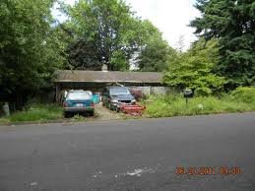
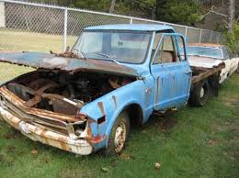
IN-OPERATIONAL VEHICLES
Sec. 8-1. - Care of premises:
(a) It shall be unlawful for the owner or occupant of a residential or commercial building, structure or property to utilize, use or permit the use of the premises of such residential or commercial property for the open storage of any abandoned motor vehicle, ice box, refrigerator, stove, glass, building material, building rubbish or similar items. It shall be the duty and responsibility of every such owner or occupant to keep the premises of such residential or commercial property clean and to remove from the premises all such abandoned items as listed above, including but not limited to weeds, dead trees, excessively tall grass, trash, rubbish, garbage, etc., upon notice from the city clerk or premises inspector.

